Slide 1





Random usefulness for
Keith Chester
thekeithchester
hlfshell
keithchester

Slide 2
What is this?
Just a couple of quick tips and things that might be useful
None of these warrant their own talk – so they get smooshed into here!

Slide 3
console
Everyone knows console.log – but you shouldn’t use it in production – why?
…so what should you do?

Slide 4
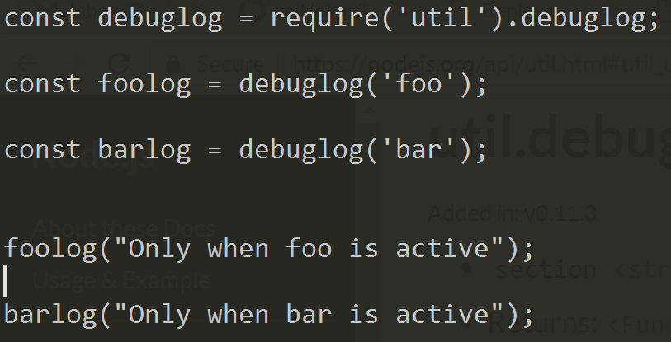
util.debug
NODE_DEBUG

Slide 5

Environment variables are a PITA
…so enter…

Slide 6
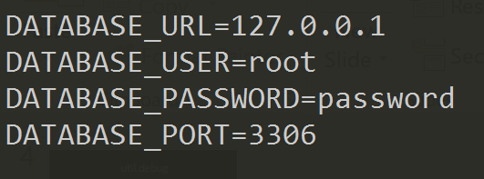
dotenv
In a file named .env

Slide 7
npm install –save-dev
Lists the installation as a dev dependency
npm install –only=dev to install only dev dependencies
npm install –only=prod to install only prod dependencies

Slide 8

async code doesn’t have to be messy

Slide 9
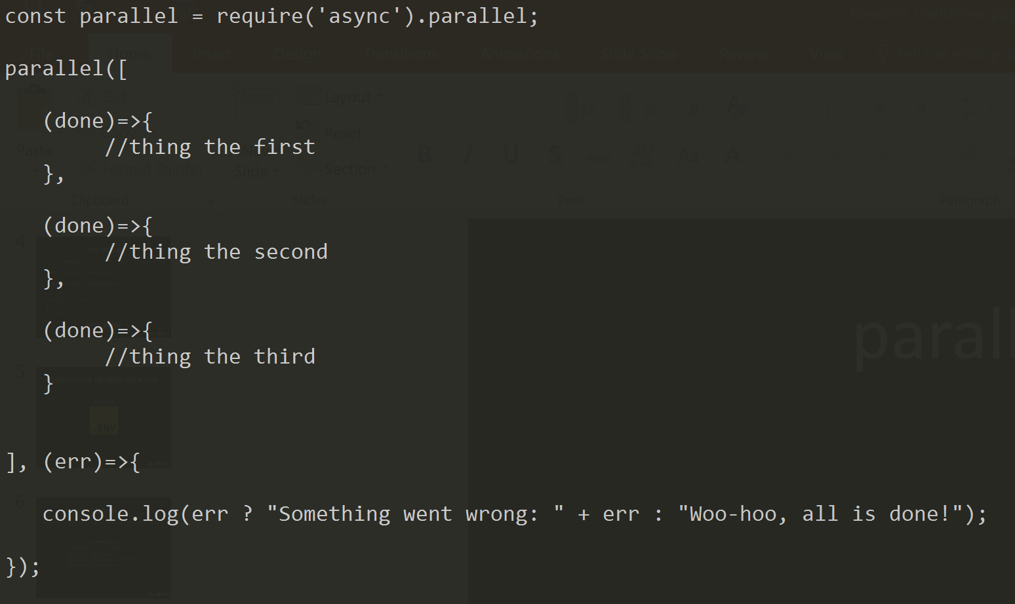
parallel

Slide 10
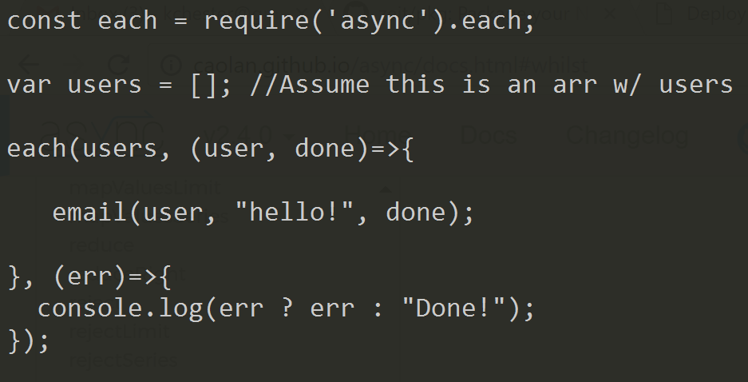
each

Slide 11
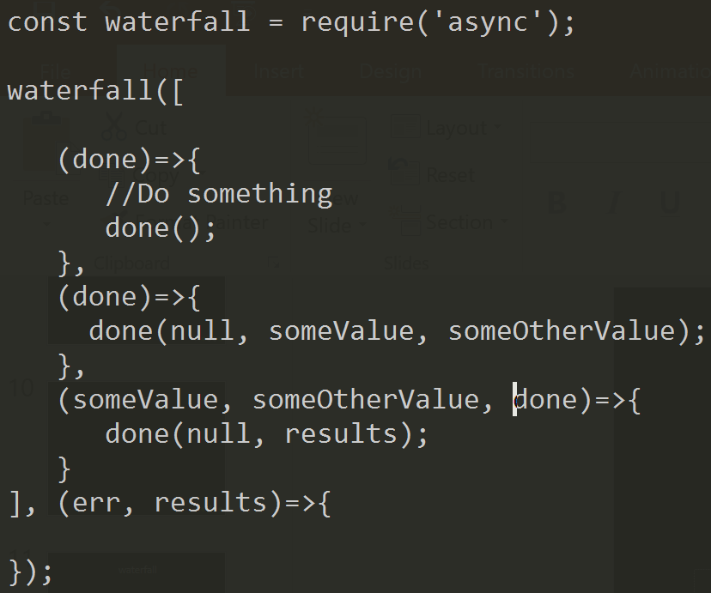
waterfall

Slide 12
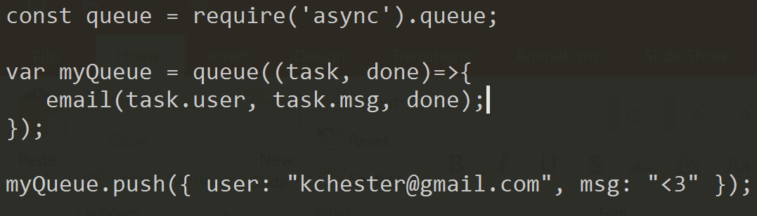
queue

Slide 13


Slide 14
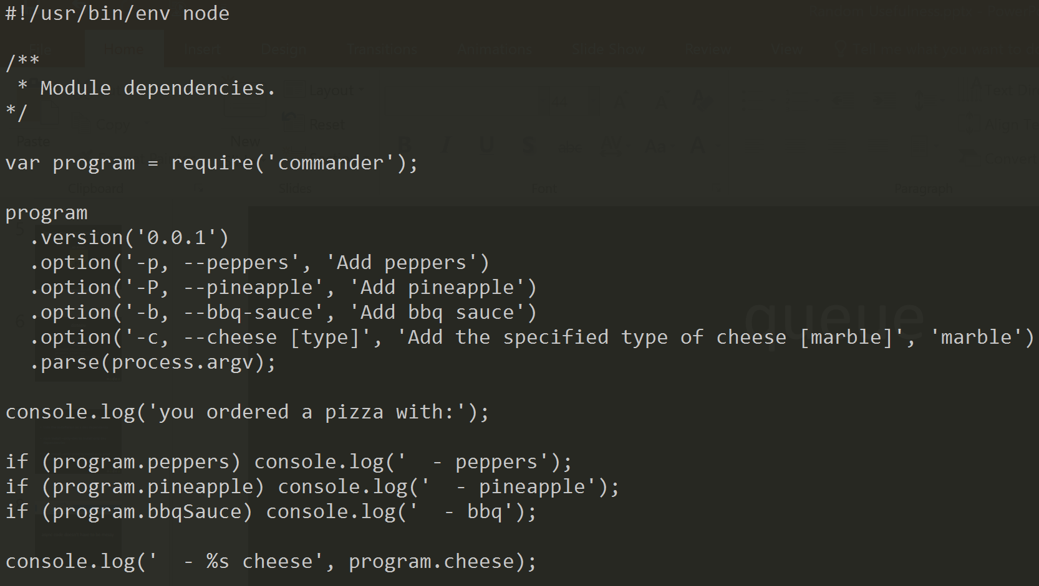
commander

